Slide 1
National Parks Visitations:
Feynman Method
Aubrey Smiley McAuliffe, Beau Findley, Jason Viehman
STAT 656, Fall 2020

Slide 2
Feynman Method Instructions
- Write down clearly and concisely what you are trying to learn. Don't write down jargon and be as specific as is reasonable.
- Explain the concept in simple language. Be on the lookout for moments in which you use terminology from this class. Seek to use the definition instead. Include a very simple example demonstrating the underlying idea.
- During the course of 2., you'll run into moments where your explanation is vague or there is something you don't understand or can't relay using non-technical language. Identify these moments here, using a list.
Seek to solidify these concepts. Go back to your notes or ask in a live session or post to the discussion board or...
Each group must submit two videos:
A 1 minute video with the same objective as Task 1. However, make a new video incorporating any relevant updates, such as new things you've learned in class or about the project (or even, that you've shifted your original project entirely).
A 5 minute video recording going through the Feynman method for a topic relevant to your project. This could be about the underlying science for the project, things related to coding, or a method you are planning on using. I want you to step through the 4 part Feynman method. For part 3., identify two concepts from part 2. that need to be addressed. Perform step 4. on these concepts and include your discussion on your new understanding of these concepts.

Slide 3
Introduction to the Business Problem
National Parks provide an invaluable service to ecosystems and the public alike, but they are run on a tight budget.
Parks must be monitored, protected, and maintained so that they may last for years to come.
Some of the funding comes from state governments and some comes from the federal government.
What characteristics do the most visited parks have in common?
Can we predict when the most people visit National Parks and Monuments and allocate funding and manning accordingly?
How do climate and socio-economic factors relate to park visitation? Are certain parks at risk and in need of more funding in coming years?

Slide 4
Steps in Analysis, Modeling, and Business Recommendations
Exploratory Data Analysis
Data Aggregation
National Parks API
Census Bureau Poverty Data
NOAA Climate Data
Join: Combining Data from each source in a usable and informative way
Clustering to Examine Parks Traffic
(Potential) Seasonal ARIMA
Exploration of temporal aspect of park visitation
(Potential) SVM or MARS
Explore non-linear relationships of features to park visitation
Gradient Boosting Machine or Neural Network
As our toolbox becomes more developed, use complex models to predict National Park traffic

Slide 5
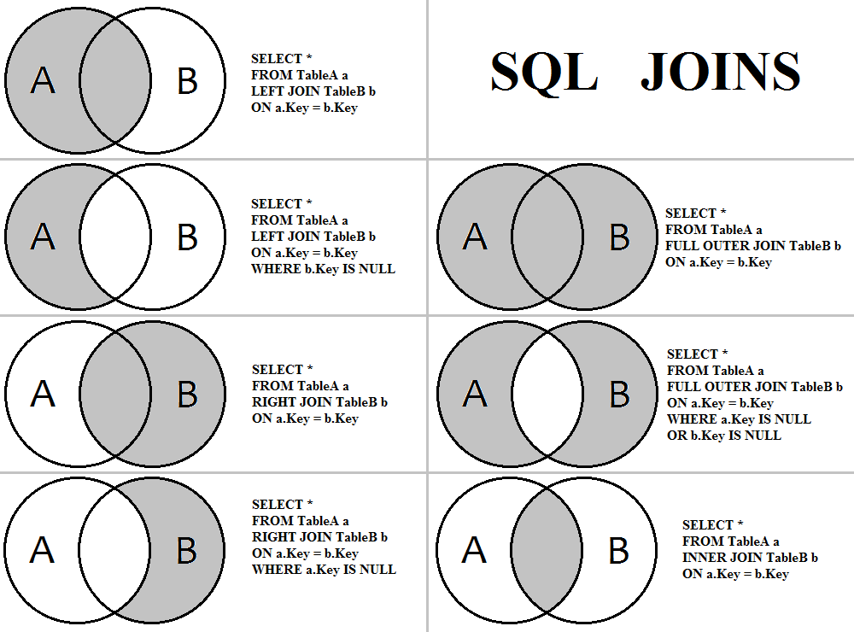
Data Aggregation Concepts – How to Execute a Join
Select
Features to be included
On
The unique keys to join on
From
The source datasets
Notes:
https://huklee.github.io/2017/01/28/021.SQL-all-kinds-of-join-queries/

Slide 6
Data Sources: An Overview
National Parks Service Data:
Which parks?
Which state?
How much traffic?
How big?
Run by states or federal government?
Poverty Data:
How is each state’s economic well-being?
Are there more families or solo-adults living in poverty?
What proportion of families have disposable income?
Climate Data:
Which county?
How much precipitation?

Slide 7
Data from National Parks Service API
3 Data Sources:
National Parks Service REST API
Parks
Park Classifications
Region
Activities
Topics (History, Geology, etc.)
Entrance Fees
Integrated Resource Management Applications (IRMA)
Acreages (Fee/Private/Gross Area)
Monthly Visitation (by person)
Monthly Visitation (by hours)
Park Anniversaries Page (NPS Website)
Park Age
Initial data processing required:
Accessing the API state-by-state
Parsing JSON formatted data into R
Stacking state level data on top of one another.
Results in one line per month per park on which the other data collected would be merged.

Slide 8
Data from Census Bureau
Small Area Income and Poverty Estimates (SAIPE)
State, National, and County collection available
1989-2018
State-level data from 1995-2018
Varying formats (csv, excel, .dat)
Removal of superfluous columns (confidence intervals)
Rearrangement of column order for older SAIPE records
Data Contents by Year:
State
Percent of Population living in Poverty
All ages
Ages 0-17
Ages 5-17, in families
Ages 0-4
Median Household Income
Combining with NPS Data:
Join SAIPE with NPS by Year and also by State, replicated for each Month within the Year

Slide 9
Climate Data
2 Data Sources (National Oceanic and Atmospheric Administration):
National Climatic Data Center (NCDC) Monthly Precipitation Data
Station name
Precipitation amount
Requests limited to 1 county and 1 year per pull
1985-2018 used
80,800 county-years used
NCDC Station Location Data
Station Name
Latitude
Longitude
40,000 stations used
Limited to 10,000 pulls per day
Initial data processing required:
Accessing the API county-by-county and year by year
Combining many data sets together due to restrictions
Running in parallel due to massive amounts of data
Results in one line per month per station on which the other data collected would be merged.

